Slide 1
Introduction
Notes:
I don’t own the pictures in the presentation. Ownership goes to the original creators

Slide 2
Agenda
What is a Version Control System?
Why do we need a version control system?
What are the different version control systems?
What is Git?

Slide 3


What is a Version Control System?
The Version control systems (VCS) are software tools that help manage changes to a set of files or a collection of code.
They track the history of modifications made to files, compare changes.
V 1.0
V 1.1
V 2.0

Slide 4



Why do we need a Version Control System?
Version control systems allow us to keep track of changes made to files and projects over time.
V 1.0
V 1.1

Slide 5




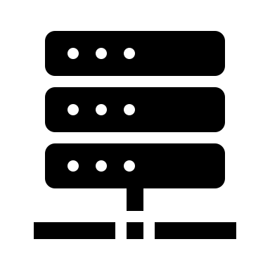


What are the different version control systems?
Centralized Version Control Systems (CVCS):
A central server that stores the entire codebase and version history.
Concurrent Versions System (CVS), Apache Subversion (SVN).
Distributed Version Control Systems (DVCS):
Each developer has a complete copy of the codebase, including its full history, on their local machine.
Git, Mercurial.

Slide 6

What is Git?
Git is a Distributed Version Control System. Git was originally authored by Linus Torvalds.
It become the most widely used version control system due to its distributed nature, speed, and powerful features.

